Slide 1

EDA- Facebook
Mushahid Khan
GCD-INSAID
Catastrophe Project Term1 &2
Linkedin

Slide 2

Contents
Facebook Data Correlation: At a Glance
Data Correlation: Likes/Likes Received/ Likes Across Platforms
Likes vs Mobile Likes : Comparison across Age Group, Gender
Likes Received vs Mobile Likes Received: Comparison across Age Group, Gender
Comparison :Age Group vs User Count/ Friend Count/ Likes/Likes Received
Age Group vs Likes/ Likes Received w.r.t. Gender
Age Group vs Friend Count/Friendships Initiated
Age Group vs Tenure/ Friend Count/ Likes/ Likes Received
Age Group/ Gender vs Tenure Likes/ Likes Received

Slide 3
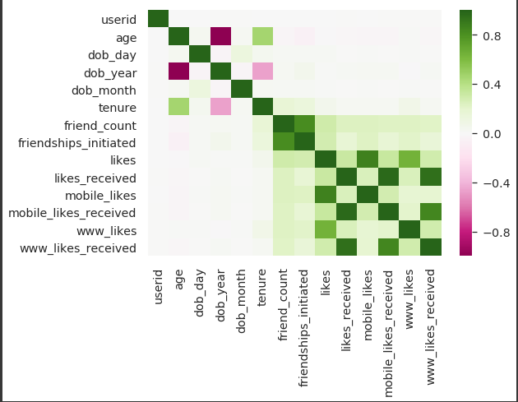
Facebook Data Correlation: At a Glance
All the ‘Like’ items are highly correlated among themselves.
Fig 1.1: Correlation Heat Map

Slide 4
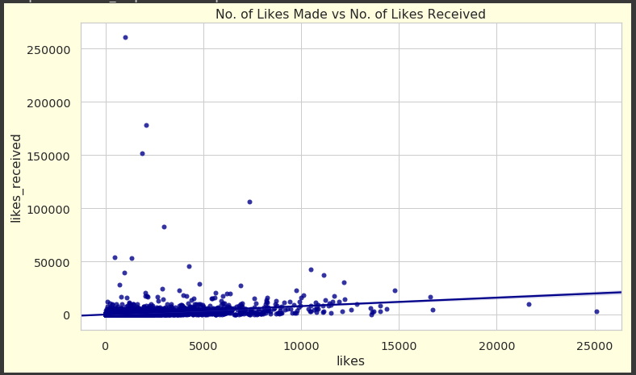
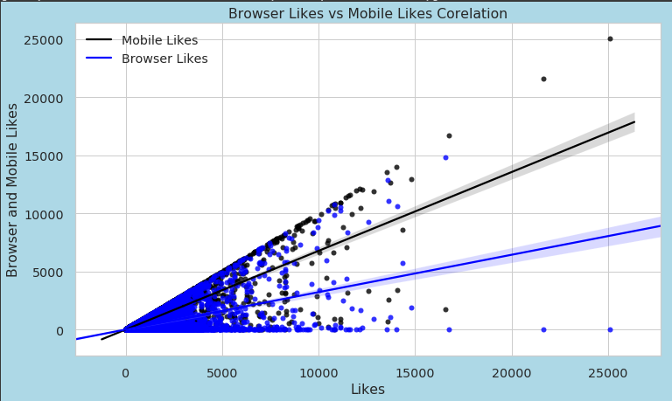
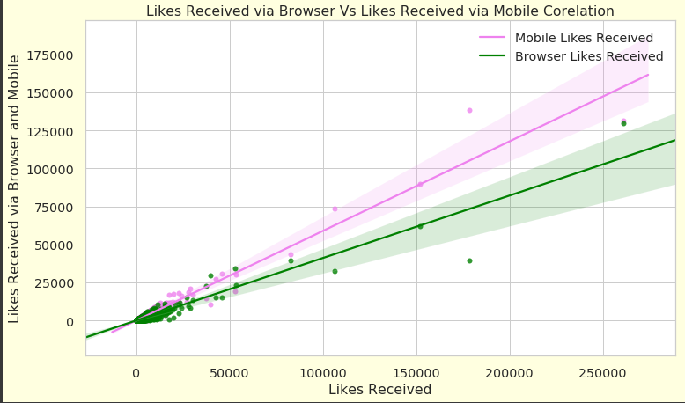
Data Correlation: Likes/Likes Received/ Likes Across Platforms
Fig 1.2: Likes vs Likes Received: Very Low Correlation
Fig 1.3: Likes vs Likes by Mobile / Likes by Browser: High Correlation. Mobile Likes are highly correlated to likes as compared to the Browser Likes.
Fig 1.4: Likes Received vs Mobile Likes Received/Browser Likes Received: Very High Correlation.
Mobile Likes Received are very highly correlated to likes received
as compared to the Browser Likes Received.
Fig 1.2 : Likes vs Likes Received
Fig 1.3 : Likes vs Browser Likes/ Mobile Likes
Fig 1.4 : Likes Received vs Browser Likes Rcvd./ Mobile Likes Rcvd.

Slide 5
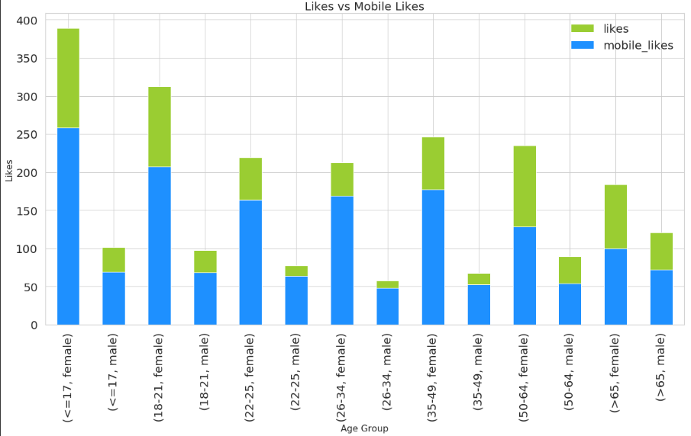
Likes vs Mobile Likes : Comparison across Age Group, Gender
Females users from the age range 17-21 have the highest likes
Females across all age groups are more active on FB.
All the users show a tendency to use FB over mobile.
The users in the age range 22-49 have the least likes and majority of them is from Mobiles. It shows they are less active on FB, and they tend to use it when they have free time. This category of users are either working professionals or involved in higher studies.
Users with the age range > 50 years, use both the Mobile as well as Web Browser in a similar ratio. This indicates that they are retired or have more free time as compared to the young age group users.
Fig 1.5 : Likes vs Mobile likes Across Age Group, Gender

Slide 6
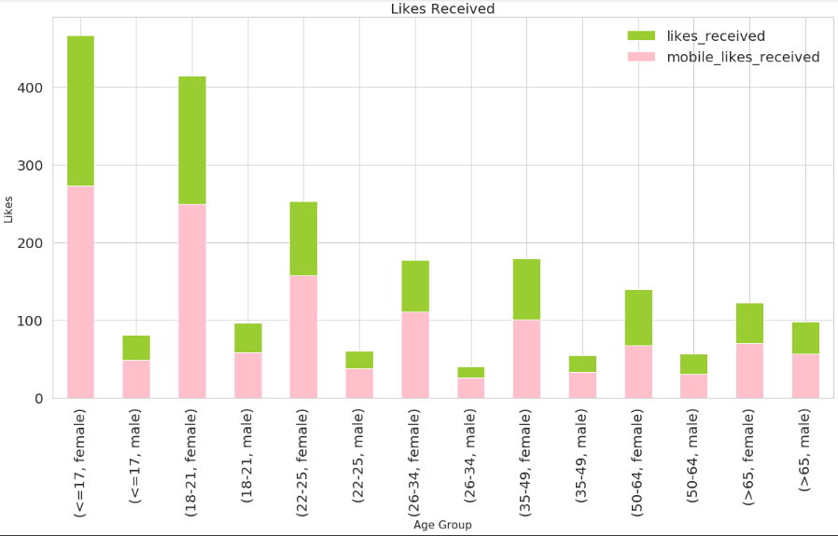
Likes Received vs Mobile Likes Received : A Comparison across Age Group, Gender
Female Users gets more likes than male users across each age group. Mobile likes received holds the edge across all the age groups.
Female users in the age range 17-21 gets the most likes. Mobile and Browser likes are equally distributed. This means they get likes from around users of all age groups.
Users from age group 21-49 have very low likes received: It can be assumed they are less active on FB or does not posts on FB regularly.
User from age group 50-64 have low likes received. This indicates they do not pull as much attention as compared to the other high likes receiving age groups.
Fig 1.6 : Likes Received vs Mobile Likes Received Across Age Group, Gender

Slide 7
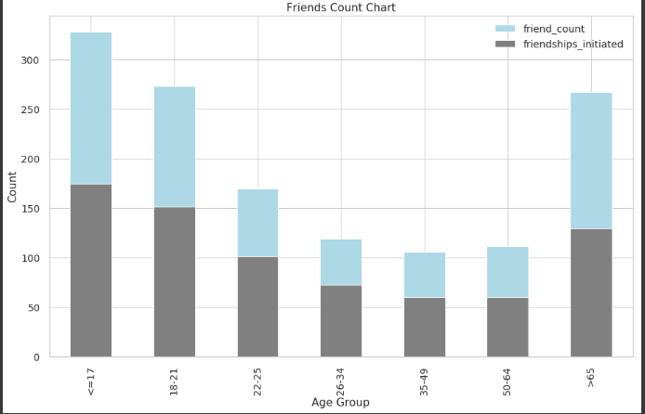
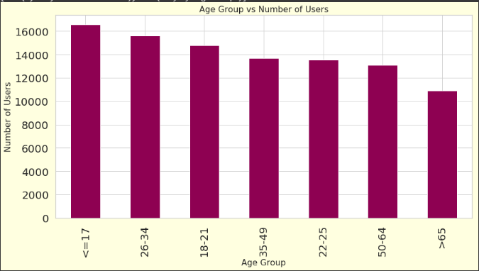
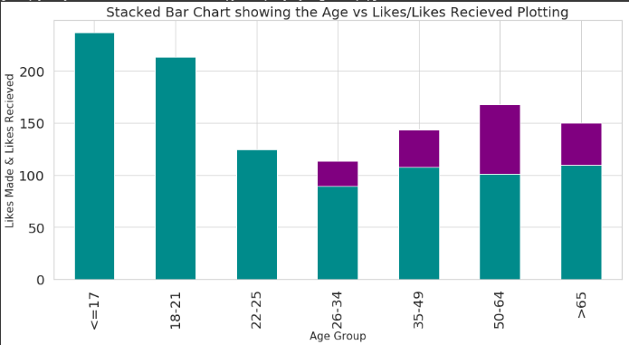
Comparison across Age Group vs User Count/ Friend Count/ Likes/Likes Received
Fig 1.7 : Age Group vs User Count
Fig 1.8 : Age Group vs Friend Count
Fig 1.9 : Age Group vs Likes/Likes Received
Fig 1.7: Users are divided across age groups to have balanced user count throughout for unbiased analysis.
Fig 1.8: In the age range 13-17, 18-21 years, Facebook have the highest user counts.
Fig 1.9: Younger age group users(till21 years) have more like received. They are most active on Facebook. Users in the age group 26-34 seems to be least active on Facebook.

Slide 8
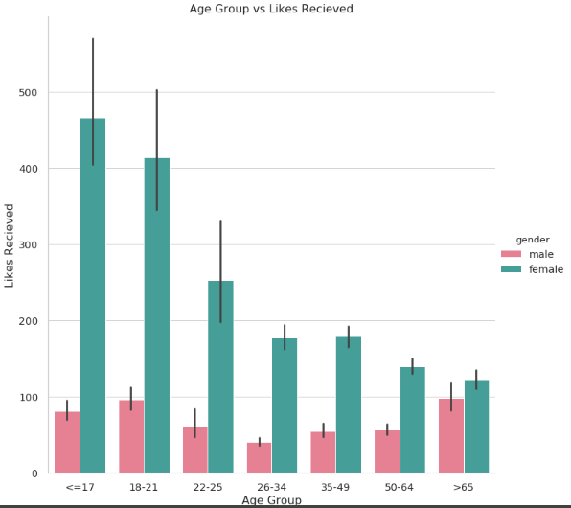
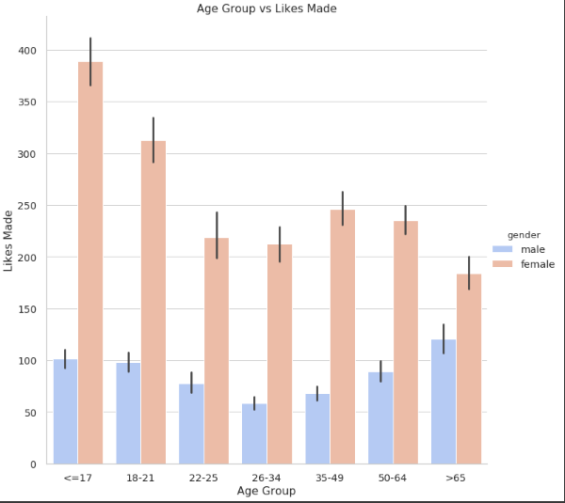
Age Group vs Likes/ Likes Received w.r.t. Gender
Fig 1.10 : Age Group vs Likes : w.r.t. Gender
Fig 1.11 : Age Group vs Likes Received : w.r.t. Gender
Fig 1.10 It can be assumed that females are expressive on Facebook. Where as males are less expressive. One insight could be that females spend more time on Facebook.
Fig 1.11: Females users in all the age groups gets more likes however in the age from 13-17, 18-21, 22-24, they have the most likes received. i.e. around 400 likes on an average.

Slide 9
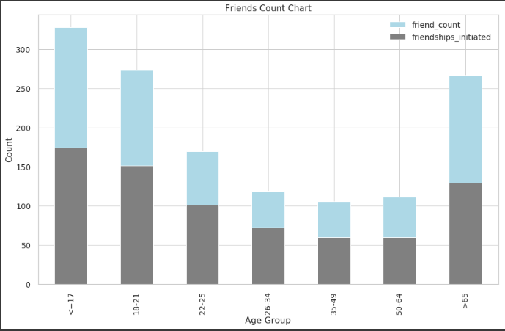
Age Group vs Friend Count/Friendships Initiated
Friendships initiated and Friend Request Received are almost evenly distributed across age groups and genders.
Female users across almost all age groups have high friend count and friendships Initiated/ Friend Requests Received compared to male users.
Old age group users have more friend count/ Friendships Initiated/ Friend Request Received for males than females.
Fig 1.12 : Age Group vs Friends Count

Slide 10
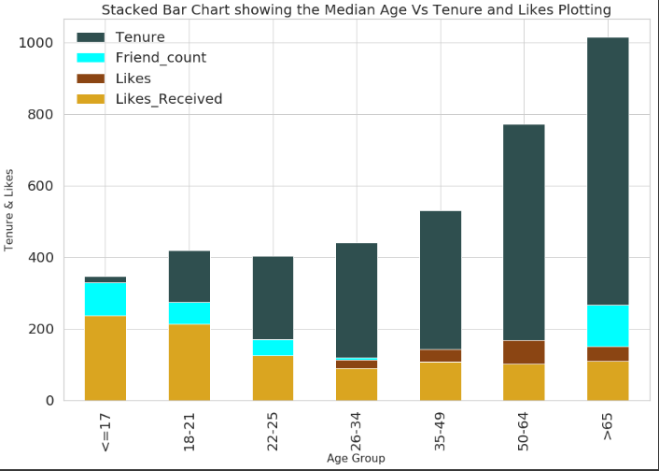
Age Group vs Tenure/ Friend Count/ Likes/ Likes Received
Old age users have more tenure at Facebook.
More the Friend Count the users have, more the likes hits by those users on their friends posts.
Young age Group users get more likes.
Old Age Group users hits more likes.
Fig 1.13 : Age Group vs Tenure vs Likes/ Likes Received vs Friend Count

Slide 11
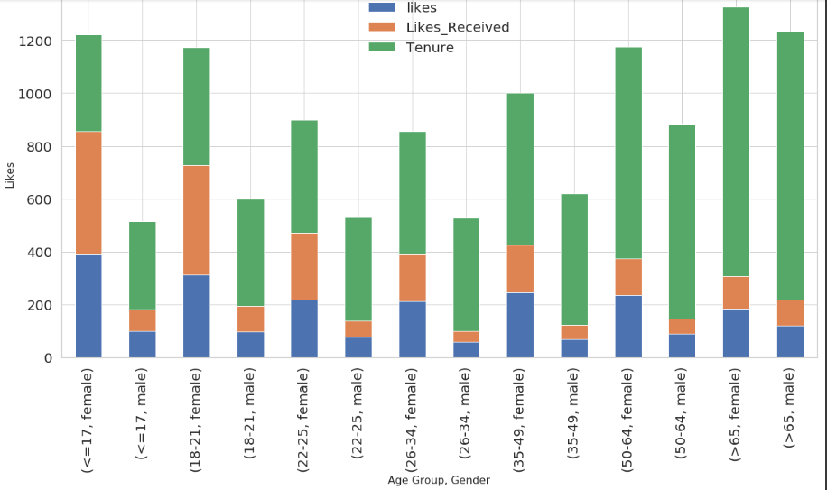
Age Group/ Gender vs Tenure Likes/ Likes Received
Female users across age-groups have more tenure compared to the males from that age group.
The ratio of tenure between males and females across age-groups is as high as 200% till the age group of 21. Hence till the age of 21,for every 2 females users joining Facebook, 1 male user joins Facebook.
For each age group the likes received and the likes are more for females compared to the males.
The ratio between male & female likes/likes received is almost 180 % in the younger age groups however it gradually decreases to 105%.
Fig 1.14 : Age Group vs Tenure vs Likes/ Likes Received vs Friend Count

Slide 12
Conclusion
Female users are more active on Facebook than male users. They have a clear edge over males in hitting likes on user’s posts.
Male Users from the age range 22-49 are least active on Facebook. This age group represents a major chunk of working professionals
Majority of the Facebook users are from the age group 16-24. Major chunk of these users are females.
Female users have high friend count, high likes , high likes received and high tenure as compared to the same age group males.
Most Liked users on Facebook are the female users of the age range 14-24.
Almost all students/ working professionals use Mobile to access Facebook. Most of them use Facebook in their free time as rest of the time they are busy with work/studies.
Friendship Initiated and Friend request received are evenly distributed across all age groups.
Friend Count is directly proportional to Likes: High Correlation.
Young age Group users get more likes.
Old Age Group users hits more likes. They also have more tenure as compared to other age group users.

Slide 13
Actionable Insights
Facebook can initiate some added services keeping in mind the users from age group 22-49 which will result in increasing the use time for these users.
Facebook can take some initiative to target the males from younger age group <21 years. The user count in this age range are very high for females and there is scope for Facebook to get the male users join Facebook to increase the graph of their overall user count.
Most popular users on Facebook are females from age range 14-24. Facebook can plan to introduce more services targeting these users to increase their revenue further.
Old Age group users spend most time on Facebook compared to other users. As most old age people are retired and spend good amount of their time reading newspapers. Facebook can plan to introduce a news section to engage these users more to Facebook and target more users from this age group to join Facebook.
As most of the Facebook users are students, Facebook can plan to introduce some educational content to get more use time from this group of users. In turn Facebook will gain on its revenue.

Slide 14



